Slide 1
Description of the Information System Product and its comparison to existing systems
Description:
A web application that can allow users to enter their usernames and generate a detailed analysis on their GitHub behavior.
The application will make API calls to the GitHub API endpoints, extract user information on repositories, commits, etc., and then perform calculations and further analysis based on the response received, and display the analysis result in a visualized format to the users.
The application will automate the analysis tasks and generate new insights based on existing data, making information more accessible for users.
Comparison:
The existing GitHub endpoints only provide general information such as ‘listing the repositories of a user.’ However, further analysis can be performed on these information to generate deeper insights on a user.
Moreover, users need to be familiar with API technologies in order to retrieve information from the GitHub endpoints.
This application can automate the tasks of information retrieval and make information and new insights about GitHub users more accessible to everyone.

Slide 2
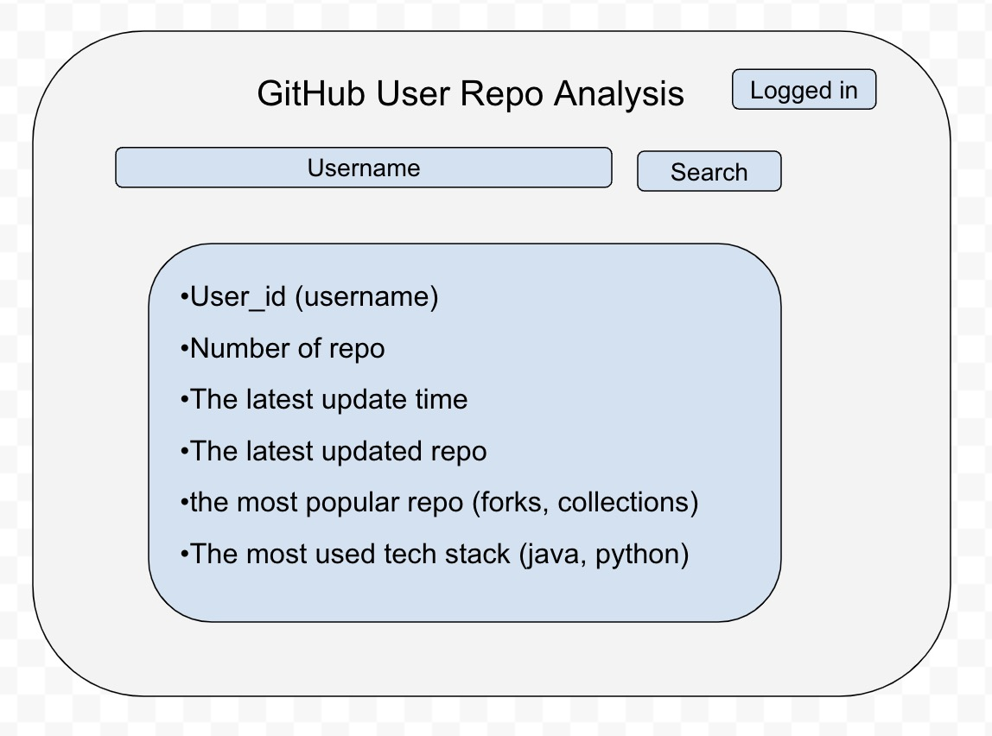
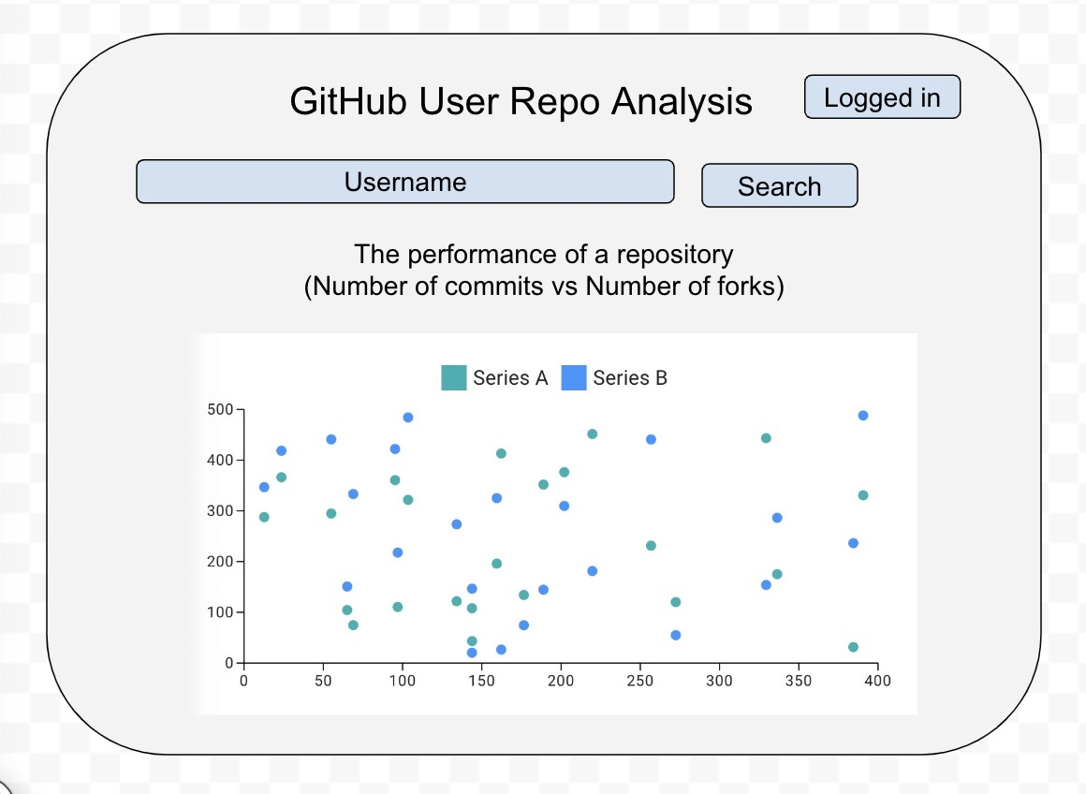
Information wireframes
Information extracted
from GitHub API endpoints
New insights generated from the information extracted

Slide 3
Description of main concepts
Controlled vocab list
Accepted term | Variant terms | Meaning
name | No variant terms seen yet | The name of the repository
description |  | The description of the repository
language |  | The main language used in the repository
forks_count |  | The number of forks of the repository
stargazers_count |  | The number of star gazers of the repository
created_at |  | The creation time of the repository
updated_at |  | The recent update time of the repository
Total_popularity_score | None | Calcualted based on information retrieved from the GitHub endpoint. This can be calculated based on the forks_count and stargazers_count to measure how popular a repository is
Age_of_repository | None | Calcualted based on information retrieved from the GitHub endpoint. By calculating the difference between ‘updated_at’ and ‘created_at’, we can measure how long the repository has been active

Slide 4
Basic Architecture for System
Information structure:
Repo information extracted from GitHub API endpoints
e.g.
- name of the repo
- number of commits of that repo
- creation and update time of the repo
2. Repo analysis derived from information extracted from the API
e.g.
name of the repo
Total popularity score of the repo (calculated)
Age of repository (calculated)
Hosting:
Localhost/Cloud hosting/Netlify
Technologies:
Frontend:
React & TypeScript, Material UI
Backend (if needed):
Java & SpringBoot / Python & Flask

Slide 5
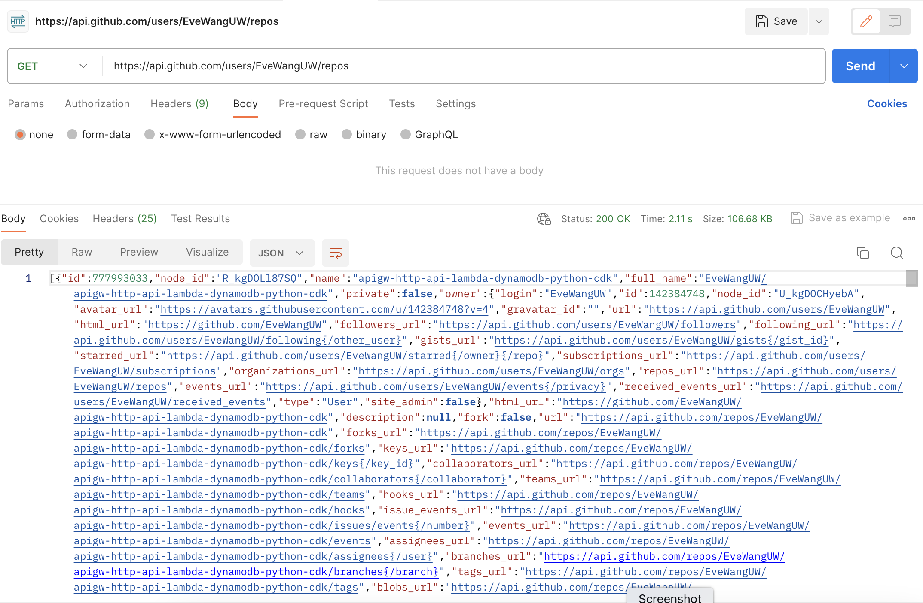
Other: current progress on API calls
Get GitHub User's Public Repos

Slide 6
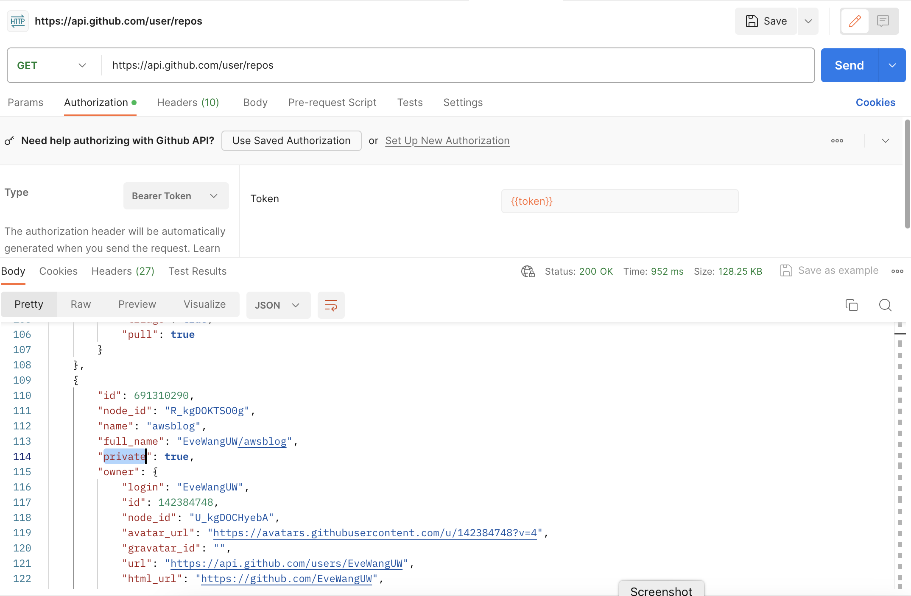
Other: current progress on API calls
Get GitHub User's Public and Private Repos

Slide 7
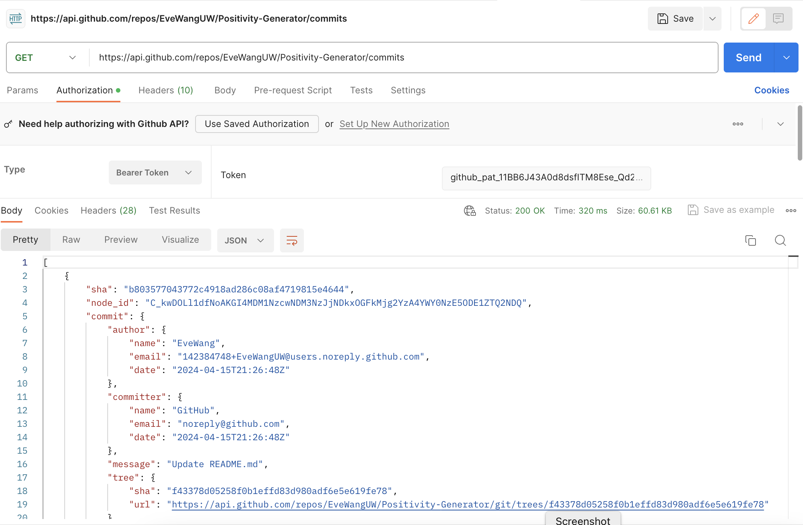
Other: current progress on API calls
List GitHub Commits from Repo

